Slide 1
GAP DATA PLATFORM
Data Quality

Slide 2
GDP DQ key Parameters
Accuracy
Completeness
Validity
Timeliness
Consistency
Integrity
‘Thresholds/ Expressions validated for required metrices’
‘each sale record, in Sale table should have an order id associated to it’
‘total_amount ’ field in the Sale table should not be ‘0’
‘Capture the delay in Ingested data streams’
‘Each Sale Record, should only have one Sale Code associated to it’
‘Field ‘Sale_Code’ should be unique for a specific sale record across all the tables – Sale, Sale_line_Discount, Sale_line_tax, Sale_tender & Sale_line_item
IDF (Developed by Accenture) is the tool / Accelerator selected for DQ Analysis

Slide 3


DQ BLOCK DIAGRAM
CORE Storage
PRODUCERS
Base
Base + 1
Base + n
DQ Exception
KAFKA
Event Dataframe
Stream Exception Data
Batch Exception Data
Rules.json
Delta Tables
DQ Master
DQ STREAM PROCESS
RULES PREPROCESSOR
DQ BATCH PROCESS
DQ Stats
DQ Process Execution
DQ Micro Batch
Threshold based
LOG
ANALYTICS
Batch
ALERTS
Stream
POWER BI
Batch and Stream
IDF Storage

Slide 4
DQ RULES IN Prod
SL # | RULES | SCOPE
1 | Null Validation | Check Missing value in the column provided by user
2 | Latency check | Check the SLA for data flow latency
3 | Duplicate check | Check Duplicate value based on the column provided by user.
4 | Count validation | Count of dataset level between source and destination
5 | Custom-expr (Pattern, Length, regex ) | Pattern Validation for fields like email, phone number, credit card number validation
6 | Straight-lookup (Referential Integrity) | Referential integrity check e.g., order has a line item or not
7 | Dependent Data Latency | Latency check between dependent data so that it met required SLA.
8 | Aggregation analytics check | Aggregation check based on BMC level
9 | Custom-expr for complex type (Array of structs) | Pattern Validation for complex type of array of structs

Slide 5


Rules configuration & pre-processing
Rules.json
PRODUCERS
DELTA TABLES
DQ RULES PRE-PROCESSOR
DQ Master
Triggers
Link to metadata rules – https://confluence.gapinc.com/pages/viewpage.action?spaceKey=DPL&title=Data+Quality+Producer+Onboarding+Pipeline

Slide 6
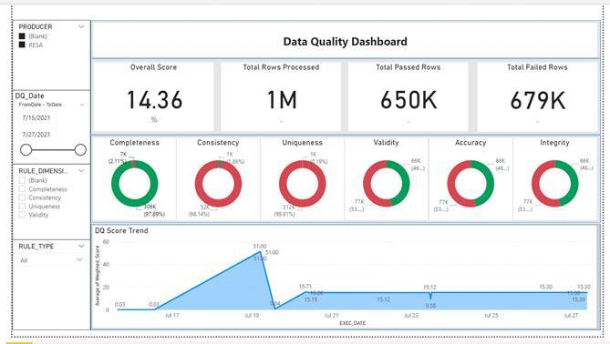
DQ Sample Dashboard - Demo

Slide 7
Q&A
Thank You!

Slide 8
APPENDIX

Slide 9





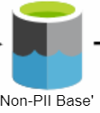

PII Zone
DQ Batch Process
Decrypt
PII topics
Ingestion Job
PII Raw BASE e w/ customer key
Rules Applied here for PII and Non PII columns:
Count Validation
Latency Check
Duplicate Check
Null Check
Custom-expr
PII Token Lookup tables e w/ customer key
Tokenization Job
Run Tokenization on the dataframe returned from DQ UDF.
After tokenization, call DQ UDF with tokenized dataframe for :
Security breach: token pattern validation (whether token matches for UUID4 pattern for the PII columns).
Depending on output of step 3 DQ UDF if failed_rule_id is not null or empty string, tokenize job should stop streaming data to Non-PII Base.
Non PII Zone
Check
Failed_rule_id = ‘’ OR Failed_rule_id is NULL
Run DQ Batch Job with Pattern validation on PII columns
Failed_rule_id != ‘’ OR Failed_rule_id is not NULL
Stop tokenize writeStream

Slide 10
